Slide 1
Guam Department of Education reconsideration evaluation plan
By: Internal Audit Office
Dated: July 26, 2019

Slide 2
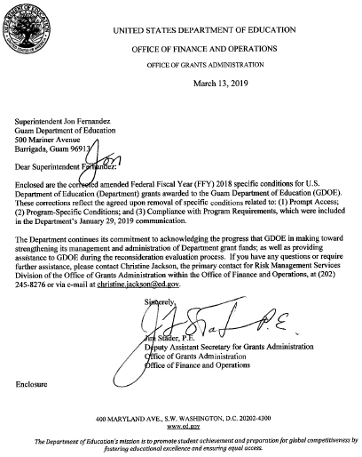
Table of contents
Background
Timeline
Changes in Specific Conditions
Reconsideration Evaluation Plan
REP vs. CCAP
REP Purpose
REP Process
Virtual vs. On-site Review
ED’s July 2019 Visit

Slide 3
BACKGROUND
The U.S. Department of Education (ED) designated the Guam Department of Education (GDOE) as a high-risk grantee.
Special conditions required GDOE to develop a Comprehensive Corrective Action Plan (CCAP) to address GDOE’s high-risk designation.
ED visited GDOE in July 2009 and concluded in their Sept. 2009 letter that GDOE made limited progress in addressing the fiscal management deficiencies that affected its administrations of ED funds.
ED issued amended special conditions that required GDOE to contract with a Third Party Fiduciary Agent (TPFA) to assist GDOE with the CCAP implementation.
Special conditions required GDOE to revise its CCAP to include tasks with measurable objectives and increase alignment with Education Department General Administrative Regulations.
GDOE has achieved significant completion rates. The Internal Audit Office (IAO) initiated validation of GDOE’s CCAP reporting.
FFY 2003
July & Sep. 2009
Nov. 2009
FFY
10~12
2017-2018
FFY 2007

Slide 4
BACKGROUND
ED issued its Amended FFY 2018 Specific Conditions letter and final REP to GDOE. The CCAP requirement was replaced with the REP.
Superintendent sent his request for reconsideration of the special conditions to ED.
ED Office of Elementary and Secondary Education representatives conducted an on-site REP validation review for property management processes.
May 2018
June 2018
Jan.
2019
March 2019
May 2019
July 2019
ED issued its Federal Fiscal Year (FFY) 2018 Specific Conditions letter, acknowledging certain progress that GDOE made.
ED issued its (Corrected) Amended FFY 2018 Specific Conditions letter. Four conditions remain relative to the TPFA, REP, and Single Audits.
Superintendent and senior level officials met with ED officials in Washington, DC.

Slide 5
Change in specific conditions
(Corrected) FFY 2018 Amended Specific Conditions:
Requirement for a TPFA
Responsibilities of GDOE and TPFA
REP
Single Audits
Prompt Access
Program-Specific Conditions
Compliance with Program Requirements
FFY 2012-2018 Specific Conditions:
Requirement for a TPFA
Responsibilities of GDOE and TPFA
CCAP
Single Audits
Prompt Access
Program-Specific Conditions
Compliance with Program Requirements
FFY 2018 Amended Specific Conditions:
Requirement for a TPFA
Responsibilities of GDOE and TPFA
REP
Single Audits
Prompt Access
Program-Specific Conditions
Compliance with Program Requirements

Slide 6
REP vs. CCAP
The REP is a comprehensive document and is not a mere replacement of the CCAP.
CCAP (09/30/18)
REP (02/01/19)
22 required actions
34 implementation deliverables
no specific deadlines
20 required actions
48 benchmarks
138 deliverables (documentation of completion)
Due dates from February 15 to Dec 31, 2019

Slide 7
REP: Purpose
The Reconsideration Evaluation Plan (REP) is designed to:
Provide clear guidance to GDOE on actions that it must take and complete during the reconsideration process;
Inform ED the extent to which specific conditions may be removed and the extent to which financial management responsibilities may be returned incrementally (or otherwise) to GDOE; and
Inform ED whether GDOE has taken all necessary actions to render it capable of performing the financial management responsibilities currently performed by the TPFA, resulting in the removal of the requirement for the TPFA.
The REP was based on ED’s specific conditions, the 2005 Office of Inspector General audit report, and the ED’s review and assessment of the status of the GDOE CCAP quarterly reports, which include pending CCAP actions.
Notes:
The OIG audit was conducted in 2003 and issued in 2005. The last status update was provided to Congress in 2006.

Slide 8
REP: Reconsideration process
The reconsideration process involves evaluating GDOE’s progress on meeting the requirements in ED’s FFY 2018 Specific Conditions; and takes into account GDOE’s CCAP quarterly report.
ED will conduct its review of the documentation (virtual and on-site) for sufficiency and, in particular instances, will conduct multiple on-site reviews throughout FFY 2019 to complete the evaluation process.
Successful completion of tasks in the REP, will dictate ED’s preparation to modify or remove specific conditions, to include the TPFA oversight when appropriate.
(Corrected) Amended FFY 2018 Specific Conditions:
Requirement for a TPFA
Responsibilities of GDOE and TPFA
REP
Single Audits
REP:
Employee Time Tracking (ETT)
Financial Management Information System (FMIS)
Internal Controls (IC)
Procurement (P)
Property Management (PM)

Slide 9
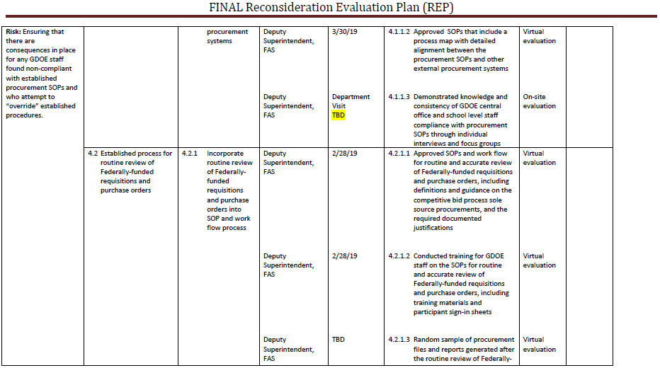
Screenshot of REP

Slide 10
Virtual vs. on-site review
ED’s virtual review of submissions involve the divisions responsible for each risk area. For example, Supply Management Office for documentation under Procurement.
The responsible staff will submit documentation to the IAO. The IAO will review and validate the documentation for sufficiency, and submit sufficient documentation to ED.
ED’s on-site review interviews with staff from divisions and schools. The staff must be able to demonstrate their knowledge and compliance with certain procedures. The on-site pre-assessment review will be conducted next week by ED relative to procurement, property management, internal controls and FMIS.
Notes:
Virtual is GDOE’s deliverables. On-site is ED’s documented evidence.

Slide 11
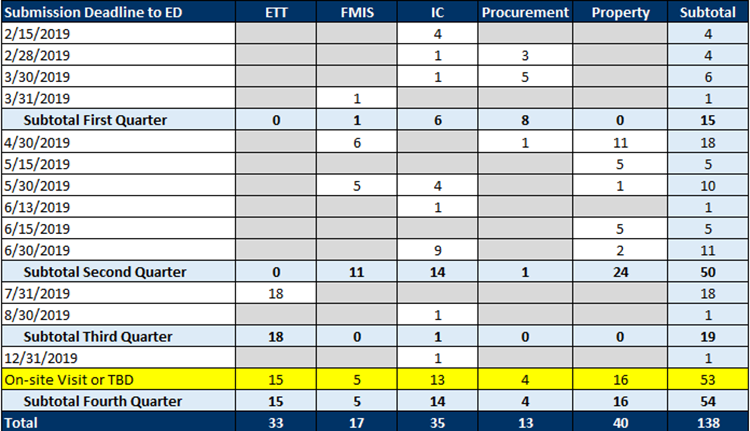
REP Deadlines

Slide 12
Ed’s july 2019 visit
From July 29 to August 3, 2019, three ED officials will be conducting a pre-assessment onsite review.
Christine Jackson, Risk Management Services
Emily Whyte, Internal Controls
Jamila Smith, Innovation and Early Learning Programs
Based on the draft ED Meeting Schedule, dated July 25, 2019, ED’s visit will consist of:
Meetings with the Guam Education Board (GEB), Superintendent, Office of Public Accountability (OPA), Deloitte and Touche, LLP (Deloitte), Guam Legislature, and Office of the Governor
Entrance and exit meetings with GDOE REP Leadership
Interviews and meetings with GDOE central office and school staff

Slide 13
Ed’s july 2019 visit (CONT’D.)
Monday, July 29, 2019
Entrance Meeting with the Superintendent and GDOE REP Leadership
FMIS – status of modules, real-time demo, and updates based on REP implementation
Training – SOPs on procurement, time and effort, and property management
Tuesday, July 30, 2019
Meetings with the OPA, Deloitte, and GEB
Internal controls – audit plan, status of Management of Internal Controls, REP submissions, and status of Standard Operating Procedures (SOPs) validation and testing
Procurement – significant changes to procurement procedures based on REP
Training – SOPs on procurement, time and effort, and property management

Slide 14
Ed’s july 2019 visit (CONT’D.)
Wednesday, July 31, 2019
Meeting with the Guam Legislature
Time and Effort – demonstration of FMIS payroll enhancements, live transactions, demonstration of internal controls based on time and effort, three-way match and four-way match of time and effort
Property Management – outstanding issues identified during virtual reviews and May 2019 on-site visit, physical inventory planning and preparation, GDOE warehouse visit, tour of GDOE IT and FMIS facilities, FMIS interface, and SOP updates
Thursday, August 1, 2019
ED courtesy visit to CNMI and follow-up meetings with GDOE REP Leadership
Friday, August 2, 2019
Courtesy visit with the Office of the Governor and Exit Meeting with GDOE

Slide 15
Contact information
Chief Auditor Franklin Cooper-Nurse
E-mail: fjtcooper-nurse@gdoe.net
Work phone: (671) 300-1336
Auditor Zchalyn Peralta
E-mail: zcperalta@gdoe.net
Work phone: (671) 300-1359
Auditor Joy Bulatao, CGFM
E-mail: jvbulatao@gdoe.net
Work phone: (671) 300-3695
GDOE Internal Audit Office
E-mail: iao@gdoe.net
Website: http://www.gdoeiao.weebly.com/
Mailing Address: 501 Mariner Avenue,
Barrigada, Guam 96913

