Slide 1
Guam Department of Education high risk progress
By: Internal Audit Office
Dated: September 16, 2019

Slide 2
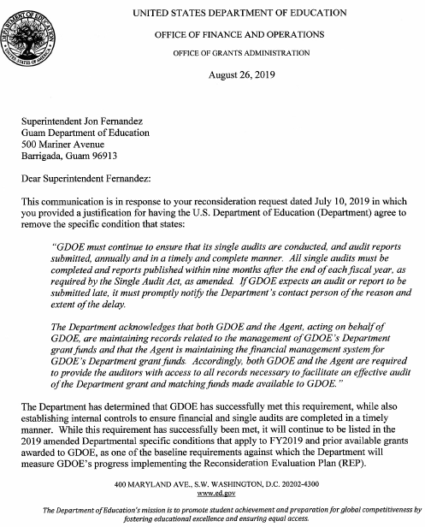
Table of contents
Background
Timeline
Changes in Specific Conditions
Reconsideration Evaluation Plan
REP Purpose
REP Process
Virtual vs. On-site Review
ED’s July 2019 Visit
Single Audit
Next Steps

Slide 3
BACKGROUND
The U.S. Department of Education (ED) designated the Guam Department of Education (GDOE) as a high-risk grantee.
Special conditions required GDOE to develop a Comprehensive Corrective Action Plan (CCAP) to address GDOE’s high-risk designation.
ED visited GDOE in July 2009 and concluded in their Sept. 2009 letter that GDOE made limited progress in addressing the fiscal management deficiencies that affected its administrations of ED funds.
ED issued amended special conditions that required GDOE to contract with a Third Party Fiduciary Agent (TPFA) to assist GDOE with the CCAP implementation.
Special conditions required GDOE to revise its CCAP to include tasks with measurable objectives and increase alignment with Education Department General Administrative Regulations.
GDOE has achieved significant completion rates. The Internal Audit Office (IAO) initiated validation of GDOE’s CCAP reporting.
Superintendent sent his request for reconsideration of the special conditions to ED.
FFY 2003
FFY 2007
July & Sep. 2009
Nov. 2009
FFY
10~12
2017-2018
May
2018

Slide 4
BACKGROUND
ED issued its Federal Fiscal Year (FFY) 2018 Specific Conditions letter, acknowledging certain progress that GDOE made.
ED issued its Amended FFY 2018 Specific Conditions letter and final REP to GDOE. The CCAP requirement was replaced with the REP.
ED issued its (Corrected) Amended FFY 2018 Specific Conditions letter. Four conditions remain relative to the TPFA, REP, and Single Audits.
ED Office of Elementary and Secondary Education representatives conducted an on-site REP validation review for property management processes.
Superintendent issued his request for reconsideration of the Single Audit specific condition.
ED conducted their REP pre-assessment visit.
ED determined that GDOE successfully met the Single Audit requirement, but will still list it as a specific condition in its FFY 2019 specific condition letter.
June 2018
Jan.
2019
March 2019
May 2019
July 2019
Aug. 2019

Slide 5
Change in specific conditions
(Corrected) FFY 2018 Amended Specific Conditions:
Requirement for a TPFA
Responsibilities of GDOE and TPFA
REP
Single Audits
Prompt Access
Program-Specific Conditions
Compliance with Program Requirements
FFY 2012-2018 Specific Conditions:
Requirement for a TPFA
Responsibilities of GDOE and TPFA
CCAP
Single Audits
Prompt Access
Program-Specific Conditions
Compliance with Program Requirements
FFY 2018 Amended Specific Conditions:
Requirement for a TPFA
Responsibilities of GDOE and TPFA
REP
Single Audits
Prompt Access
Program-Specific Conditions
Compliance with Program Requirements

Slide 6
REP: Purpose
The Reconsideration Evaluation Plan (REP) is designed to:
Provide clear guidance to GDOE on actions that it must take and complete during the reconsideration process;
Inform ED the extent to which specific conditions may be removed and the extent to which financial management responsibilities may be returned incrementally (or otherwise) to GDOE; and
Inform ED whether GDOE has taken all necessary actions to render it capable of performing the financial management responsibilities currently performed by the TPFA, resulting in the removal of the requirement for the TPFA.
The REP was based on ED’s specific conditions, the 2005 Office of Inspector General audit report, and the ED’s review and assessment of the status of the GDOE CCAP quarterly reports, which include pending CCAP actions.
Notes:
The OIG audit was conducted in 2003 and issued in 2005. The last status update was provided to Congress in 2006.

Slide 7
REP: process
The reconsideration process involves evaluating GDOE’s progress on meeting the requirements in ED’s FFY 2018 Specific Conditions; and takes into account GDOE’s CCAP quarterly report.
ED will conduct its review of the documentation (virtual and on-site) for sufficiency and, in particular instances, will conduct multiple on-site reviews throughout FFY 2019 to complete the evaluation process.
Successful completion of tasks in the REP, will dictate ED’s preparation to modify or remove specific conditions, to include the TPFA oversight when appropriate.
(Corrected) Amended FFY 2018 Specific Conditions:
Requirement for a TPFA
Responsibilities of GDOE and TPFA
REP
Single Audits
REP:
Employee Time Tracking (ETT)
Financial Management Information System (FMIS)
Internal Controls (IC)
Procurement (P)
Property Management (PM)

Slide 8
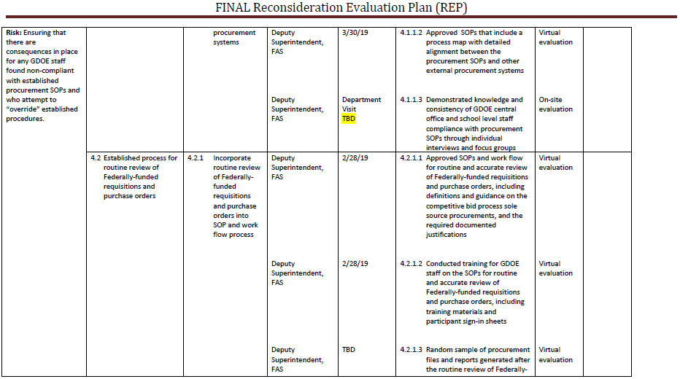
Screenshot of REP

Slide 9
Virtual vs. on-site review
ED’s virtual review of submissions involve the divisions responsible for each risk area. For example, Supply Management Office for documentation under Procurement.
The responsible staff will submit documentation to the IAO. The IAO will review and validate the documentation for sufficiency, and submit sufficient documentation to ED.
ED’s on-site review interviews with staff from divisions and schools. The staff must be able to demonstrate their knowledge and compliance with certain procedures.
Notes:
Virtual is GDOE’s deliverables. On-site is ED’s documented evidence.

Slide 10
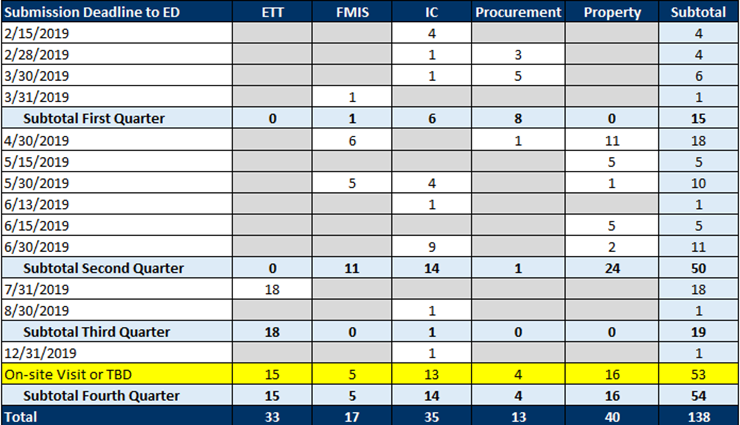
REP Deadlines

Slide 11
Ed’s july 2019 visit
From July 29 to August 3, 2019, ED officials conducted a pre-assessment visit.
Christine Jackson, Risk Management Services
Emily Whyte, Internal Controls
Jamila Smith, Innovation and Early Learning Programs
ED’s visit consisted of:
Meetings with the Guam Education Board (GEB), Superintendent, Office of Public Accountability (OPA), Deloitte and Touche, LLP (Deloitte), Guam Legislature, and Office of the Governor
Entrance and exit meetings with GDOE REP Leadership
Interviews and meetings with GDOE central office and school staff
As of September 12, 2019, ED has yet to provide the documented results of their pre-assessment visit.

Slide 12
Single audit
In FFY 2003, GDOE became a “high-risk” grantee for ED grants due to non-compliance with the Single Audit Act from FY 1998 to FY 2002; and unauditable financial statements from FY 1998 to FY 2001. Since then, Single Audits was a specific condition for GDOE.
In May 2018, the Superintendent submitted his request for reconsideration of the specific conditions, including the condition for Single Audits. However, in March 2019, ED only removed prompt access, program-specific conditions, and compliance with program requirements.
In July 2019, the Superintendent sought further reconsideration of the Single Audit condition. Single Audits is a condition reiterative of federal and local requirements; and is no longer valid.
In August 2019, ED determined GDOE has successfully met the Single Audit requirement. However, it will still be listed as a condition in the FFY 2019 specific conditions.

Slide 13
Next steps
Three specific conditions remain: (1) Requirement for a TPFA, (2) Responsibilities of GDOE and the TPFA Concerning Administration of Grant Funds, and (3) REP.
“Pending GDOE’s completion and implementation of measures that are in progress and designed to address deficiencies in its financial management and administration of ED funds, these amended specific conditions are imposed on GDOE’s ED grants to ensure that GDOE implements ED grant awards in accordance with applicable legal requirements and with appropriate fiscal accountability measures, management practices and controls.” (Preamble, ED FFY 2018 Corrected Amended Specific Conditions)
In terms of fiscal accountability measures, the Government of Guam has methods of monitoring GDOE’s compliance with laws and regulations applicable to managing ED grants.

Slide 14
Next steps (Cont’d.)
The Education Financial Supervisory Commission (EFSC) was established by Public Law 30-164 to assist the GDOE and the GEB with the task of monitoring and managing all public education financial resources.
It is the intent of I Liheslaturan Guahan to finally lift the “high risk grantee” designation. In order to achieve this, the Superintendent and GEB must avail themselves of the management and financial experience offered by the EFSC members.
The Public Auditor is required to annually audit or conduct post-audits of “all transactions and accounts of all departments, offices, corporations, authorities, and agencies in all of the branches of the government of Guam”. (Title 1 of the Guam Code Annotated Section 1908)

Slide 15
Contact information
Chief Auditor Franklin Cooper-Nurse
E-mail: fjtcooper-nurse@gdoe.net
Work phone: (671) 300-1336
GDOE Internal Audit Office
E-mail: iao@gdoe.net
Website: http://www.gdoeiao.weebly.com/
Mailing Address: 501 Mariner Avenue,
Barrigada, Guam 96913

