Slide 1
non-appropriated funds
Internal Audit Office
SY 2019-2020 Leadership Academy
July 31, 2019

Slide 2
agenda
Overview
History of Audit Performance
Audit Results: School Year (SY) 2017-2018
IAO Report
Guam Department of Education (GDOE) Fiscal Year (FY) 2018 Management Letter Comment
Administrator Responsibilities
Statutes and Procedures
Enabling Legislation
Board Policy (BP) 715
NAF Procedures
Other Matters
Frequently Asked Questions (FAQs)
Moving Forward
IAO Website and Other Resources

Slide 3
overview

Slide 4
History of audit performance
From FY 2001 to FY 2014, NAF was a consistent finding in GDOE’s compliance and Single Audit reports.
Other common findings were procurement, cash management, period of availability, allowable costs, and fixed assets.
Since FY 2015, NAF was reduced to a comment in GDOE’s management letters.
Common NAF problems identified stem from untimely cash outs in Munis and reconciliations by school personnel, and incomplete documentation.
IAO will continue to work with schools to reduce and eventually remove NAF deficiencies.

Slide 5
Audit results: SY 2017-2018

Slide 6
Iao reports
Each school activities fund shall be audited as often as required at least annually, by the GDOE Internal Audit Staff.
IAO tested the SY 2017-2018 NAF documentation of Finegayan Elementary, H.B. Price Elementary, F.B. Leon Guerrero Middle, L.P. Untalan Middle, Simon Sanchez High, and Tiyan High Schools.
Some of the schools reviewed received a marginal risk rating for internal control deficiencies due to:
No proper transition between outgoing and incoming NAF personnel;
Heavy reliance on the School Treasurer and lack of timely NAF documentation reviews by the School Administrator; or
Lack of updated SOPs.

Slide 7
Gdoe fy 2017 management letter
Opening balances did not reconcile to prior year ending balances for 18 of 41 schools, noting $37,362 of receipts and $13,541of disbursements not reported in the correct period.
Late “cash outs” = late reports = balances are posted in Munis in the next school year.
The reporting date for SY 17-18 is from July 1, 2017 to June 30, 2018.
If SY 17-18 transactions are cashed out before or after those dates, the reporting dates have to be adjusted or a reconciliation should be performed to reconcile the differences in cash balances.
Bank reconciliations were not timely and accurately performed.
Bank statements identified fewer deposits than per recorded NAF receipts.
Cash collections were transferred between sub-accounts in Munis, and were not accurately reported, or may not have been remitted to the bank.

Slide 8
Gdoe fy 2017 management letter CONT.
14 of 255 receipts tested, totaling $8,407 of $136,675, did not meet NAF receipt requirements.
No cash count sheet and/or bank receipt,
Incomplete cash count sheet or Munis entries, and
Untimely bank deposit.
4 of 224 disbursements tested, totaling $1,243 of $169,329, did not meet NAF disbursement requirements.
No vendor payment receipt or invoice, and
Disbursement not aligned with the student organization’s goals or objectives (i.e. TAF used to treat staff to breakfast at a restaurant).

Slide 9
Administrator Responsibilities
The School Principal (Administrator) is ultimately accountable for his/her school’s NAF. Part of this responsibility includes:
Being knowledgeable of applicable law and BP 715 requirements.
Ensuring an SOP is in place, updated, and implemented (e.g. staff training).
Ensuring complete documentation before approving disbursements and transfers, reconciling, and cashing out transactions on Munis.
Monthly reviews of Munis transactions against bank statements and cash outs thereafter.
Ensuring accuracy of monthly and annual reports before submission to IAO.
Ensuring proper transition of NAF responsibilities whenever a change in NAF personnel occurs.
Immediately informing IAO of any NAF issues encountered.

Slide 10
Statutes and procedures

Slide 11
Enabling legislation
Public Law 26-26 and Title 17 of the Guam Code Annotated Section 3210
The GDOE Board shall create rules and regulations necessary to regulate fund-raising activities, to safeguard funds, and for the audit of such funds.
Such rules shall include:
All purchase contracts between vendors and class activities, sponsors or school principals shall be subject to Board approval; and
A requirement that an annual audit of all school and class activity funds be performed and a report filed with the Board and I Liheslaturan Guåhan.

Slide 12
BP 715 Key points
NAF are Agency/Fiduciary Funds or money held in trust by the school.
SAF are raised by student organizations and shall be disbursed only for purposes authorized by the organization.
Campus Activity Funds/TAF are used to benefit the whole student body.
All school activity funds received by the school shall be under the custody and control of the Principal.
SOPs shall be established by each school to ensure the proper accounting for and expenditures of all school activity funds.
Monies raised by student organizations should be spent to benefit those currently in school for they are the ones who have raised the monies.
There shall be established a Money Committee within each school.

Slide 13
NAF PROCEDURES – RECEIPTS
Receipts - Whenever money is collected, a Munis receipt shall be issued by the school activities treasurer immediately.
Monies collected should be counted and verified after each fundraiser/activity (by the advisor and a secondary person).
A cash count sheet must be completed with each deposit and verified by an assigned office personnel upon receipt.
Cash received by the office should be safeguarded until deposited to the bank (deposits must take place within the same business day and no later than the next business day).
Bank receipts should be kept with NAF records.
Notes:
Receipts - Whenever money is collected, a Munis receipt shall be issued by the school activities treasurer immediately.
Monies collected should be counted and verified after each fundraiser/activity (by the advisor and a secondary person).
A cash count sheet must be completed with each deposit and verified by an assigned office personnel upon receipt.
Cash received by the office should be safeguarded until deposited to the bank (deposits must take place within the same business day and no later than the next business day).
Bank receipts should be kept with NAF records.

Slide 14
NAF PROCEDURES – Disbursements
Disbursements
Prohibited disbursements
Disbursements shall be made by check only for the purpose for which the fund was established, or purposes which the student organizations raising the funds determine.
The school principal and school treasurer’s signatures are required on each check.
No disbursement will be made unless a voucher request for payment is approved and if the account has or will have a negative balance.
The principal shall be aware of, investigate, and take timely corrective action to eliminate the cause of any negative balance in student activity accounts.
If primarily benefits school staff members or other GDOE employees, such as gifts, meals, retirement functions, or other staff social activities.
Meals not essential to the success of a meeting whose primary purpose is discussing educational or administrative matters or conducting school business.
Extension of credit or loans.
Contributions to charitable organizations, unless funds have been contributed by students for a specific charity.

Slide 15
NAF PROCEDURES – safekeeping
Safekeeping
All funds shall be deposited in a commercial bank or saving and loan association at the close of each day when possible but in any event no later than the next day.
If funds are stored at the school, funds should be kept in a secured/locked area and only accessible by NAF personnel.
Loss of Funds/Equipment
In an event of loss of funds, or equipment purchased with SAF, a written report must be made immediately to the Guam Police Department and to the Superintendent describing fully the nature and extent of the loss.
IAO should also be notified of any potential loss of funds related to NAF.

Slide 16
NAF PROCEDURES – Reports
Monthly Reports
Annual Reports
The School Treasurer shall prepare a monthly report for each fund. It shall show the previous balance, receipts and disbursements for the month and the current balance.
The report should include the month’s Munis report, bank statement, and a bank reconciliation if there is a variance.
At the close of each year (June 30), the Principal shall prepare an annual report covering the entire school year’s (SY) activities. This report shall be transmitted to Internal Audit Staff no later than July 15 of each year.
The report should include the SY’s Munis report, the June bank statement, and a bank reconciliation if there is a variance.
The Munis report should cover the months of July 20xx to June 20xx.
As July 30, 2019, IAO is pending 10 schools’ annual reports.

Slide 17
NAF PROCEDURES – Reports Cont.
Common errors with reports
Not submitting monthly NAF reports, preventing IAO from updating Quarterly Reports
Submitting incomplete reports (i.e., missing bank statements, bank reconciliations)
Principals signing off on reports that are not balanced
Entering all transactions at the end of the year
Munis reports with incorrect start and end dates

Slide 18
NAF PROCEDURES – Best practices
Ensure proper transition of NAF responsibilities
Request for an Audit
Review Standard Operating Procedures and update if needed
Review NAF balances
Update bank signatory cards

Slide 19
Other naf Matters
Notes:
Notes:
Role of the IAO
Transfers of Principals, Admin Officers/Assistants – Ensure NAF is closed out.
Any NAF issues, Inform IAO.
Reminder: Frequent cash outs to close out Fiscal Year.

Slide 20
Frequently Asked Questions
Reimbursement - When vendors do not accept checks, can a person be reimbursed if the person uses his/her personal funds to cover for the purchase? For the previous SY, this has been for online or off-island purchases.
This practice is highly discouraged as it could lead to abuse.
Please seek guidance from IAO to help ensure the transaction is clean.

Slide 21
Moving forward
NAF in Accounts Payable
Few schools’ NAF transactions are being captured by in the Accounts Payable module in Munis.
Until the issue is resolved, your school may be contacted to delete and re-enter transactions captured.
FY 2019 NAF Cash Out in Munis
Due to a Munis system upgrade in FY 2016, NAF affects GDOE’s General Ledger.
Untimely cash outs of pending NAF transactions and untimely reconciliations or close of GDOE’s ledgers hinder the completion of GDOE’s annual financial audit.
Board Policy Amendment and Overall NAF SOP

Slide 22
Iao website and other resources
NAF quarterly Munis balances, and annual Munis and bank balances and bank reconciliation are posted in the IAO website. http://gdoeiao.weebly.com/non-appropriated-funds.html
GDOE’s Financial and Single Audit Reports are posted in IAO’s website at http://gdoeiao.weebly.com/financial-and-single-audit-reports.html, and in the Office of Public Accountability’s website at http://opaguam.org/.
The reference materials (i.e. PowerPoint, handouts) used in this training and other guidance are also posted in IAO’s website. http://gdoeiao.weebly.com/advisory-services.html

Slide 23
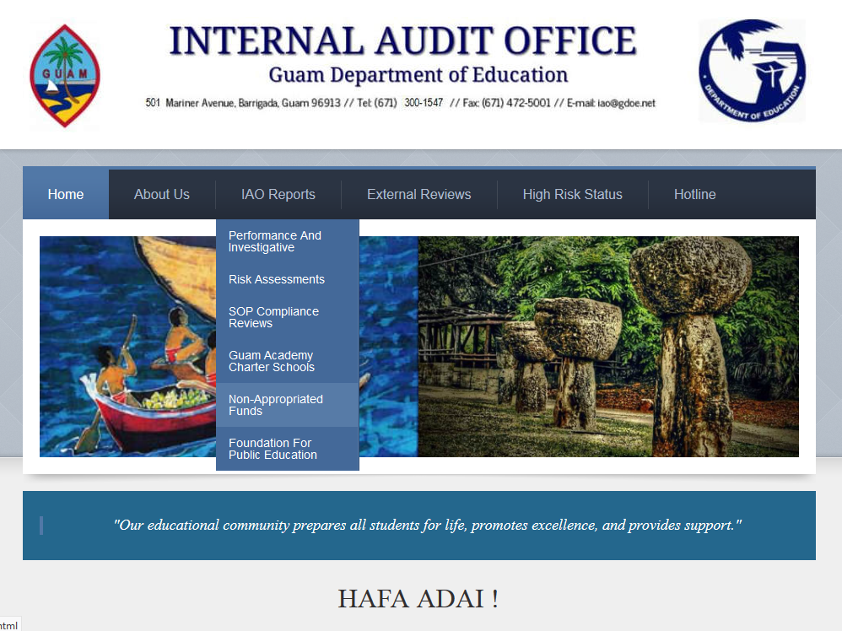
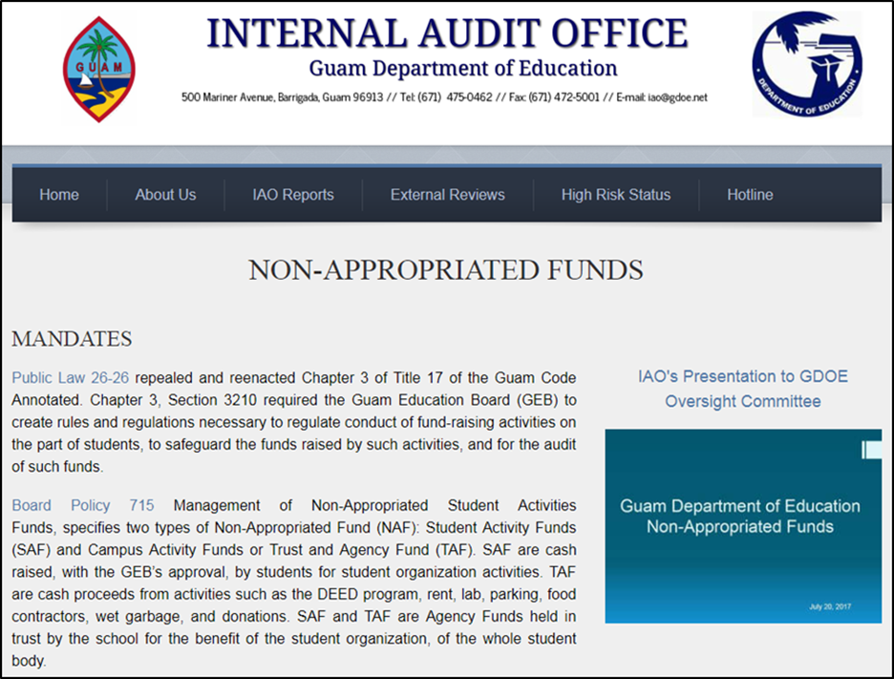

Slide 24
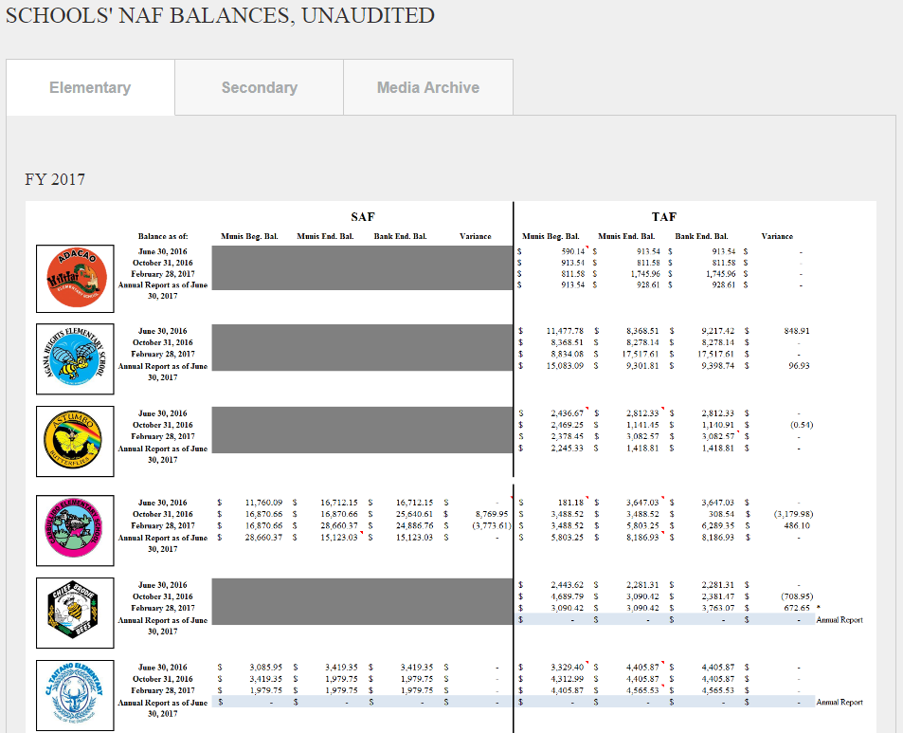
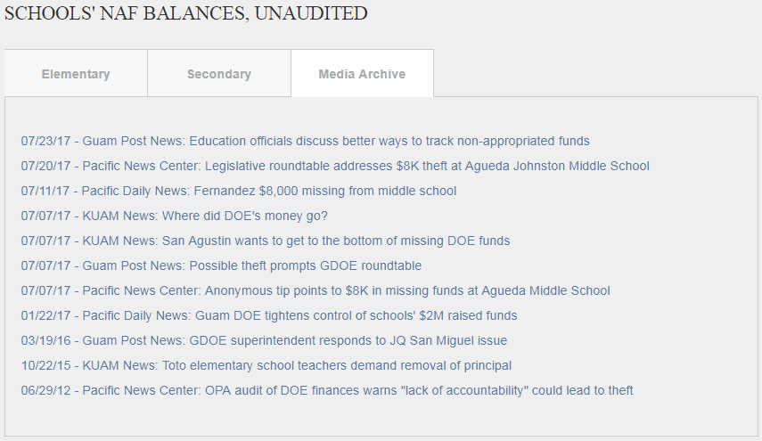

Slide 25
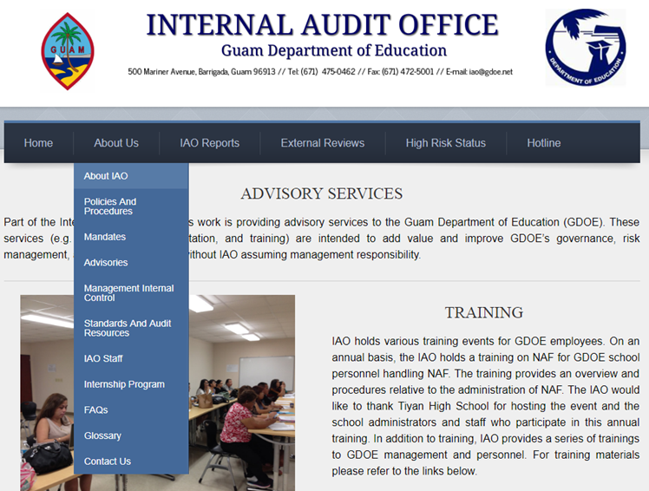

Slide 26
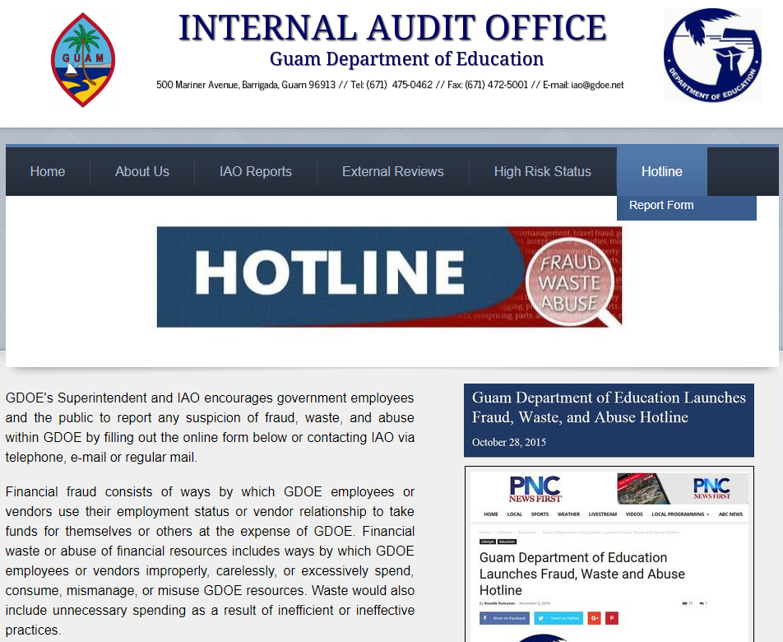
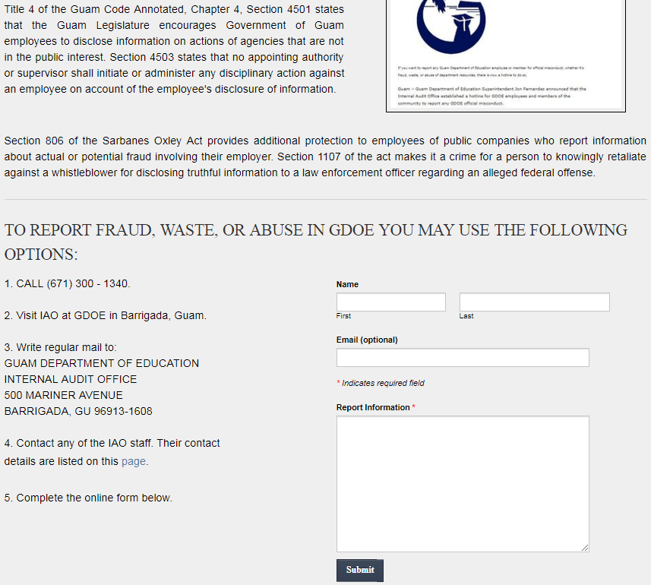

Slide 27
Contact information
Chief Auditor Franklin Cooper-Nurse
E-mail: fjtcooper-nurse@gdoe.net
Work phone: (671) 300-1336
Auditor-in-Charge Joy Bulatao, CGFM
E-mail: jvbulatao@gdoe.net
Work phone: (671) 300-3695
Auditor Carmela Vi
E-mail: cavi@gdoe.net
Work phone: (671) 300-1273
GDOE Internal Audit Office
E-mail: iao@gdoe.net
Website: http://www.gdoeiao.weebly.com/
Mailing Address: 500 Mariner Avenue,
Barrigada, Guam 96913

